Slide 1
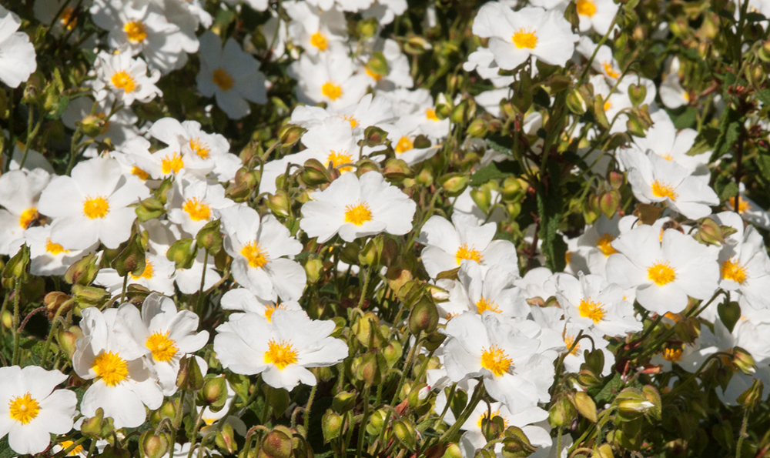

Farnham Biodiversity Group
A Biological Records Note
Visitors to Cistus x hybridus the hybrid rock rose
Dr. Martin Angel
2023

